Slide 1
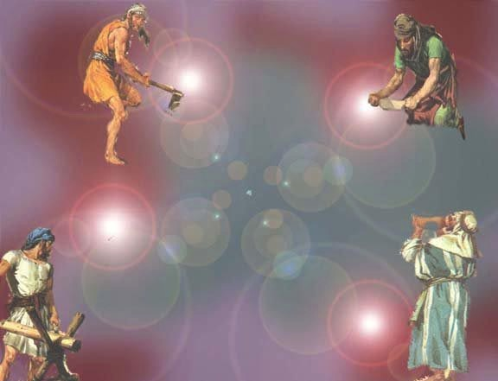
Zechariah
Dr. Rick Griffith • Jordan Evangelical Theological Seminary • BibleStudyDownloads.org

Slide 2
Key Word
649
343
Messiah
Zechariah

Slide 3
Theme
649
Rebuild Temple
for Messiah
Zechariah

Slide 4
Key Verse
649
"This is what the LORD says, 'I will return to Zion and dwell in Jerusalem. Then Jerusalem will be called The City of Truth, and the mountain of the LORD Almighty will be called The Holy Mountain'" (8:3).
Zechariah

Slide 5

Kingdom Statement
343
Judah must rebuild the temple (6:9-15) for blessing in the Messiah's kingdom.
Zechariah

Slide 6

Summary Statement
649
346
Judah must prepare for the Messiah in light of her privileged covenant position among the nations by rebuilding the temple for future blessings when the Messiah rules in the kingdom.
Zechariah

Slide 7

Covenant
347e
Eight covenant visions (1:7–6:8) depict Israel's privileged position and judgment on the nations based on God's promise to Abraham to bless those who bless them and curse those who curse them (cf. Gen. 12:1-3).
Zechariah

Slide 8

Redemption
347e
God's salvation of Jews from many countries of exile (8:7, 13) will come through a humble King (9:9) who brings salvation like a Shepherd (9:16) who was pierced (12:10-13).
Zechariah

Slide 9

Messiah
347e
Christ is the humble King (9:9) who will die for the nation (12:10-13; 13:7) to bring forgiveness (10:1) and salvation at his second coming (ch. 14).
Zechariah

Slide 10
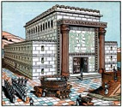
Book Chart
Rebuild Temple for Messiah
God's Covenant Faithfulness |  |  | Future Messianic Rule
Chapters 1–6 |  |  | Chapters 7–14
"The word of the LORD came to Zechariah…" (1:1) |  |  | "The word of the LORD came to Zechariah…" (7:1)
Visions of the Covenant |  |  | Visions of the Messiah
 |  |  |  | Two Burdens
Command to Repent 1:1-6 | Eight Covenantal Visions 1:7–6:8 | Joshua's Symbolic Coronation 6:9-15 | Four Restoration Messages 7–8 | Rejected at First Advent 9–11 | Received at Second Advent 12–14
"The word of the LORD came to Zechariah" | "Then I looked up—and there before me" | "The word of the LORD came to me" | "The word of the LORD came to me" | "The burden of the word of the LORD" (NASB) | "The burden of the word of the LORD" (NASB)
Pictures |  |  | Problems | Predictions
Israel's Fortune |  |  | Israel's Fasting | Israel's Future
While Building the Temple 520-518 BC (1:1; 7:1) |  |  |  | After Building the Temple 480-470 BC (9:13?)
Jerusalem
649
Rebuild Temple for Messiah
Zechariah

Slide 11
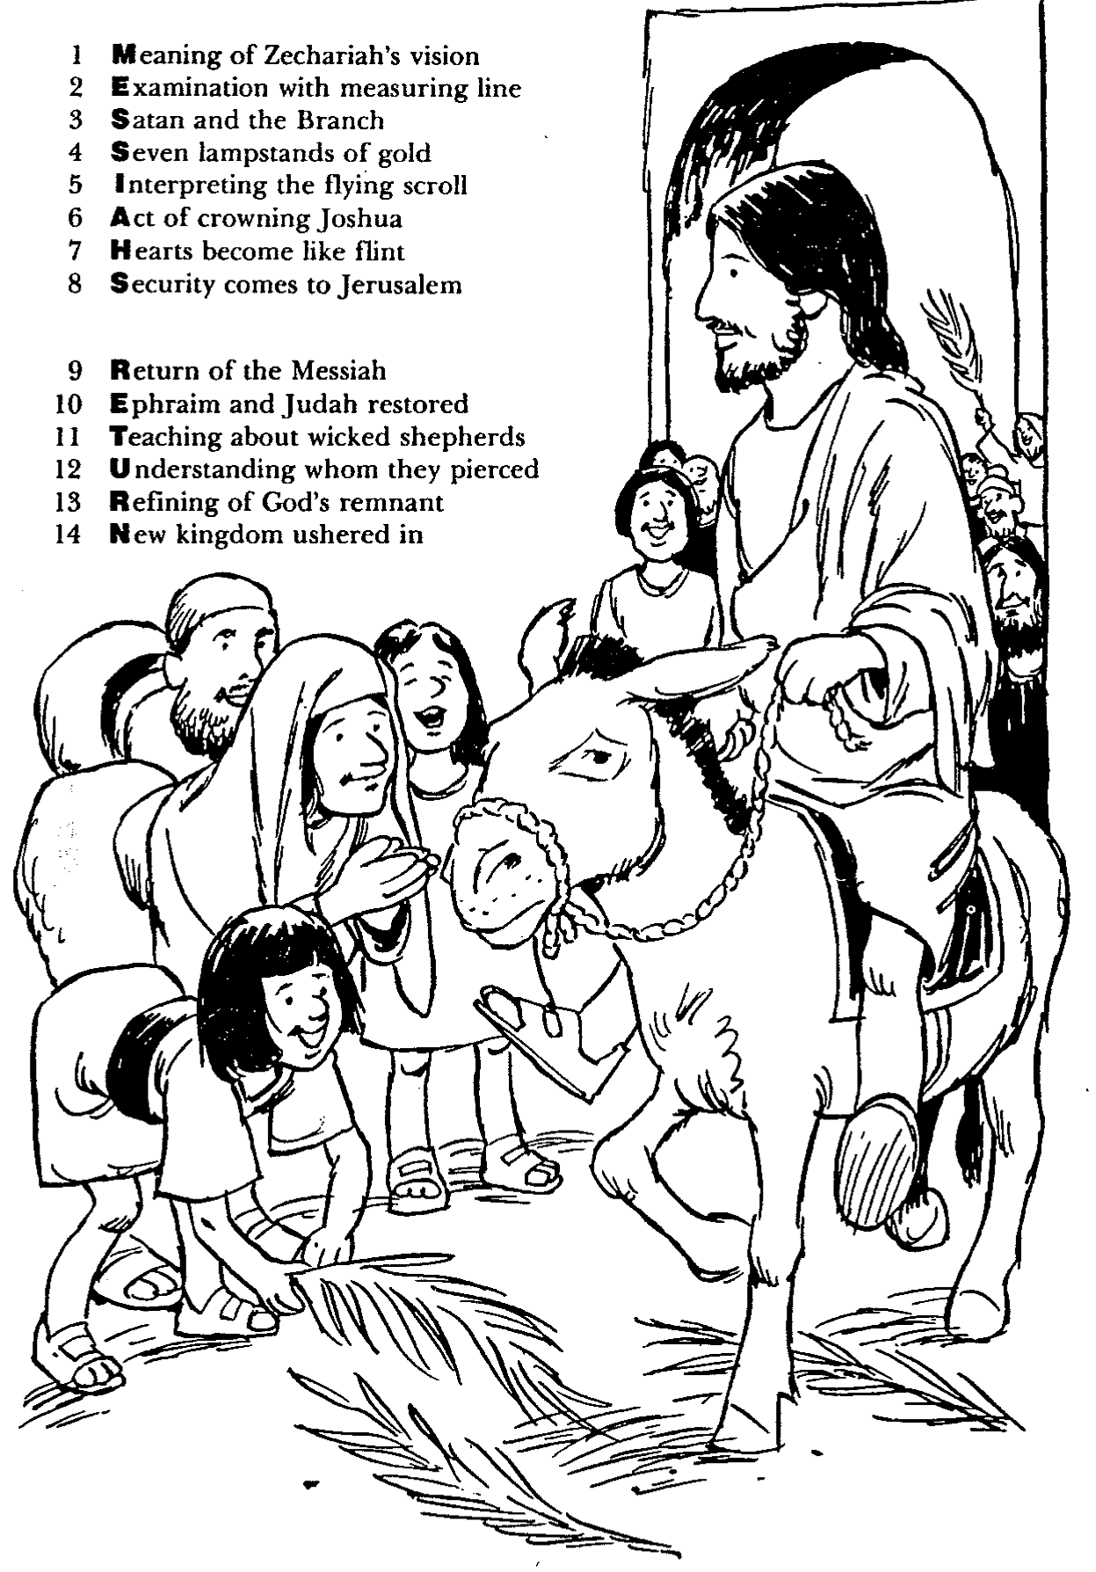
Barry Huddleston, The Acrostic Summarized Bible (Grand Rapids: Baker, 1992)
Zechariah
1 Meaning of Zechariah’s vision
2 Examination with measuring line
3 Satan and the Branch
4 Seven lampstands of gold
5 Interpreting the flying scroll
6 Act of crowning Joshua
7 Hearts become like flint
8 Security comes to Jerusalem
9 Return of the Messiah
10 Ephraim and Judah restored
11 Teaching about wicked shepherds
12 Understanding whom they pierced
13 Refining of God’s remnant
14 New kingdom ushered in

Slide 12
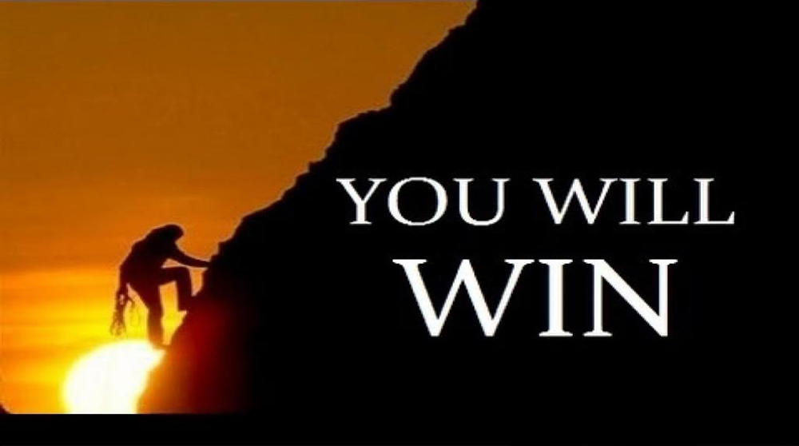
Be Encouraged
Zechariah
Dr. Rick Griffith • Crossroads International Church Singapore
BibleStudyDownloads.org

Slide 13
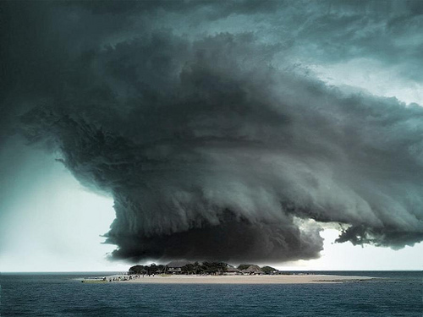
Discouragement.
Zechariah

Slide 14

Discouragement while serving Jesus is real.
Zechariah
the struggle is real
DISCOURAGEMENT

Slide 15
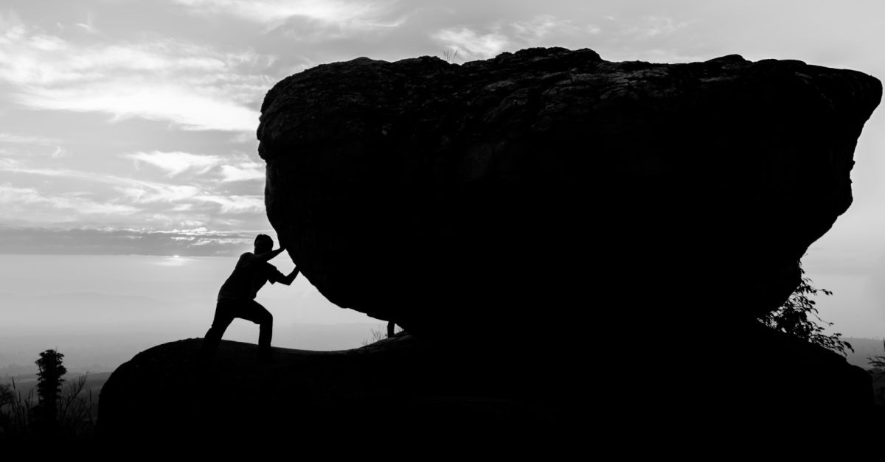
How can you be encouraged in your service for Christ?
Zechariah

Slide 16
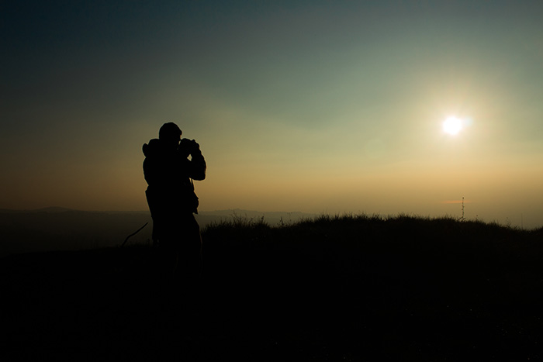
Main Idea
The way to fight discouragement is to...
see who you are
and where you are going.
Zechariah

Slide 17
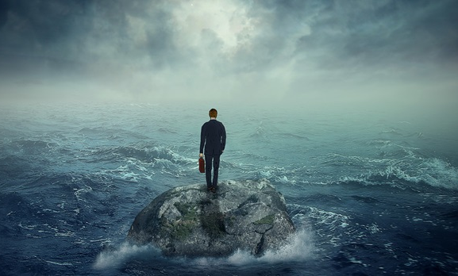
I. See your privileged position.
Zechariah 1–6

Slide 18
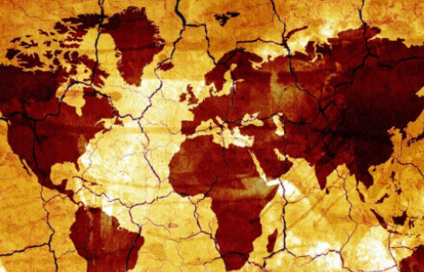
II. See your glorious future.
Zechariah 7–14

Slide 19

Questions to Ponder
How can you better understand your exalted position in Christ?
————————
How can you better serve Christ now in light of your rule with him at his return?
Zechariah

Slide 20
Black

Slide 21
Be Encouraged
Zechariah
Dr. Rick Griffith, Crossroads International Church Singapore
BibleStudyDownloads.org

Slide 22
Discouragement.

Slide 23
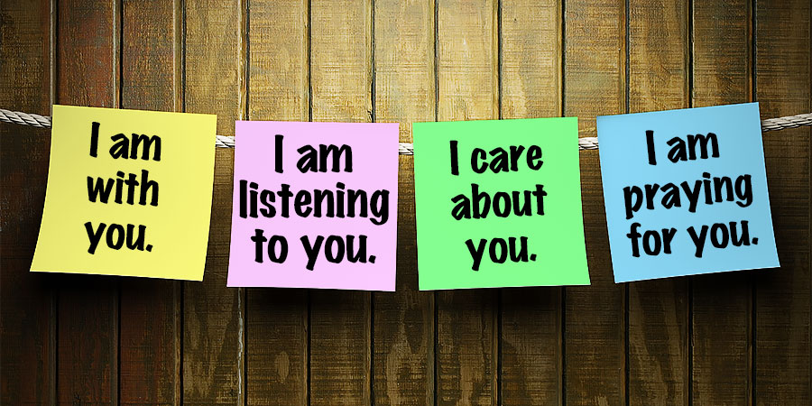
We all need encouragement

Slide 24
Discouragement.

Slide 25
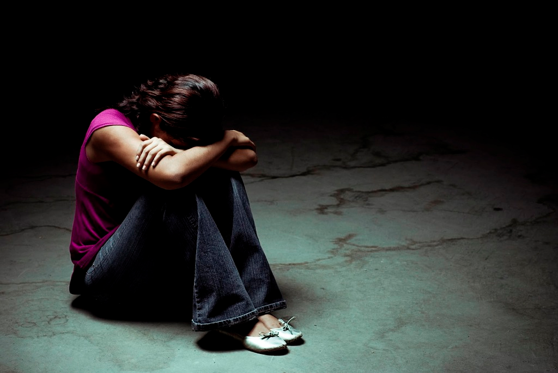
Discouragement.

Slide 26
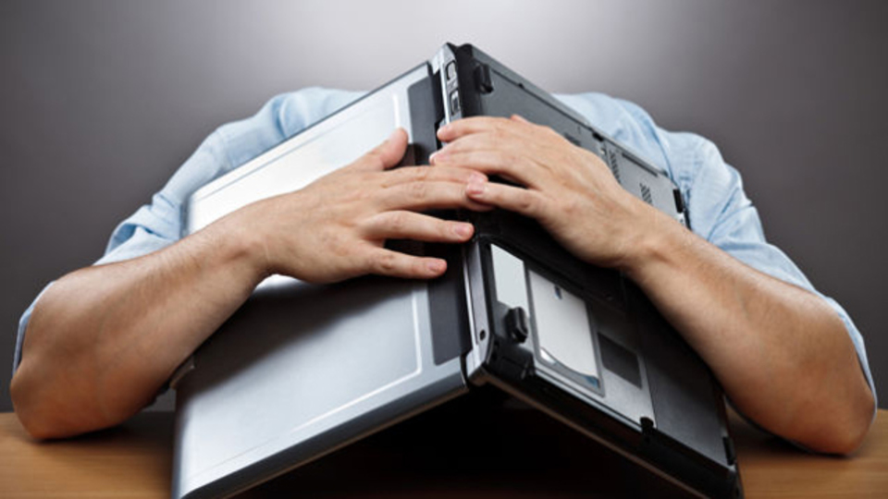
Discouragement especially happens with work.

Slide 27
Discouragement while serving Jesus is real.

Slide 28
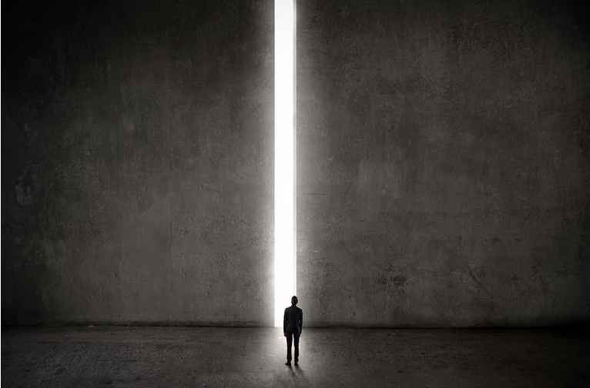
http://www.lawrencewilson.com/stop-saying-1700-pastors-leave-the-ministry-every-month/
Stop saying
"1,700 Pastors Leave the Ministry Every Month"
REALLY?

Slide 29
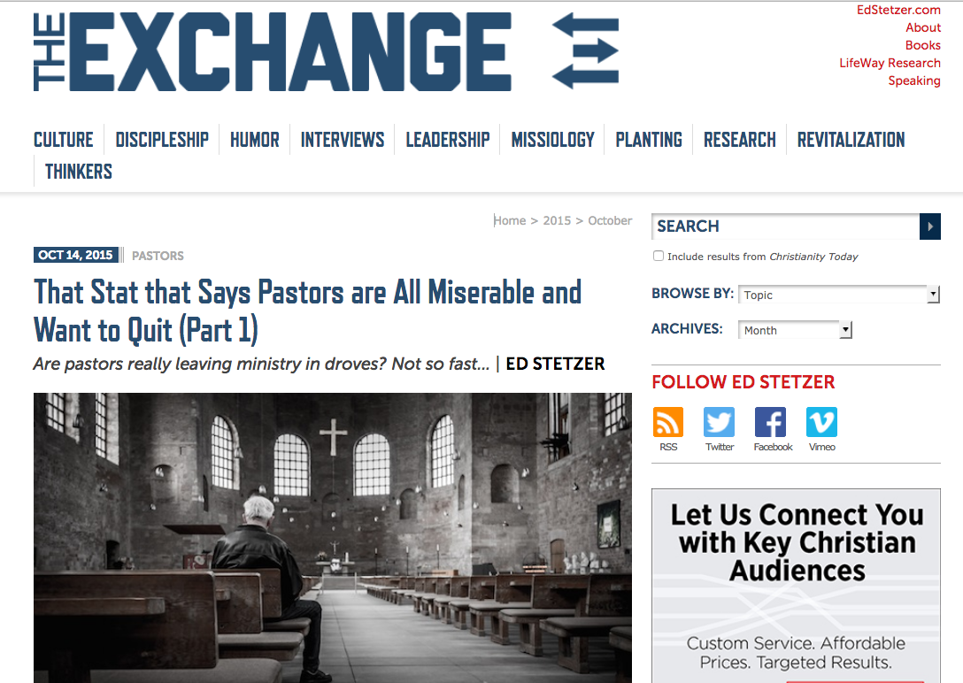
http://www.christianitytoday.com/edstetzer/2015/october/that-stat-that-says-pastors-are-all-miserable-and-want-to-q.html
Are All Pastors Miserable and Want to Quit?

Slide 30
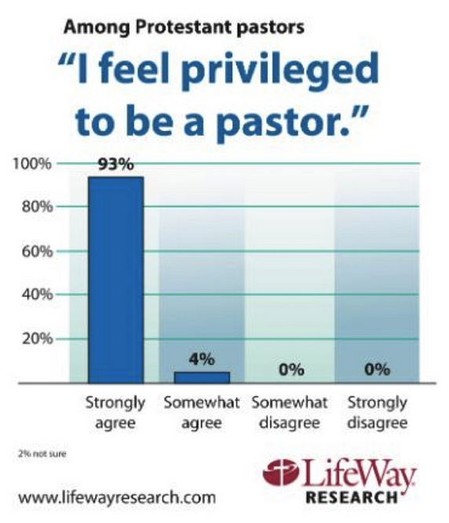
http://lifewayresearch.com/2015/09/01/despite-stresses-few-pastors-give-up-on-ministry/
Are All Pastors Miserable and Want to Quit?

Slide 31
How can you be encouraged in your service for Christ?

Slide 32
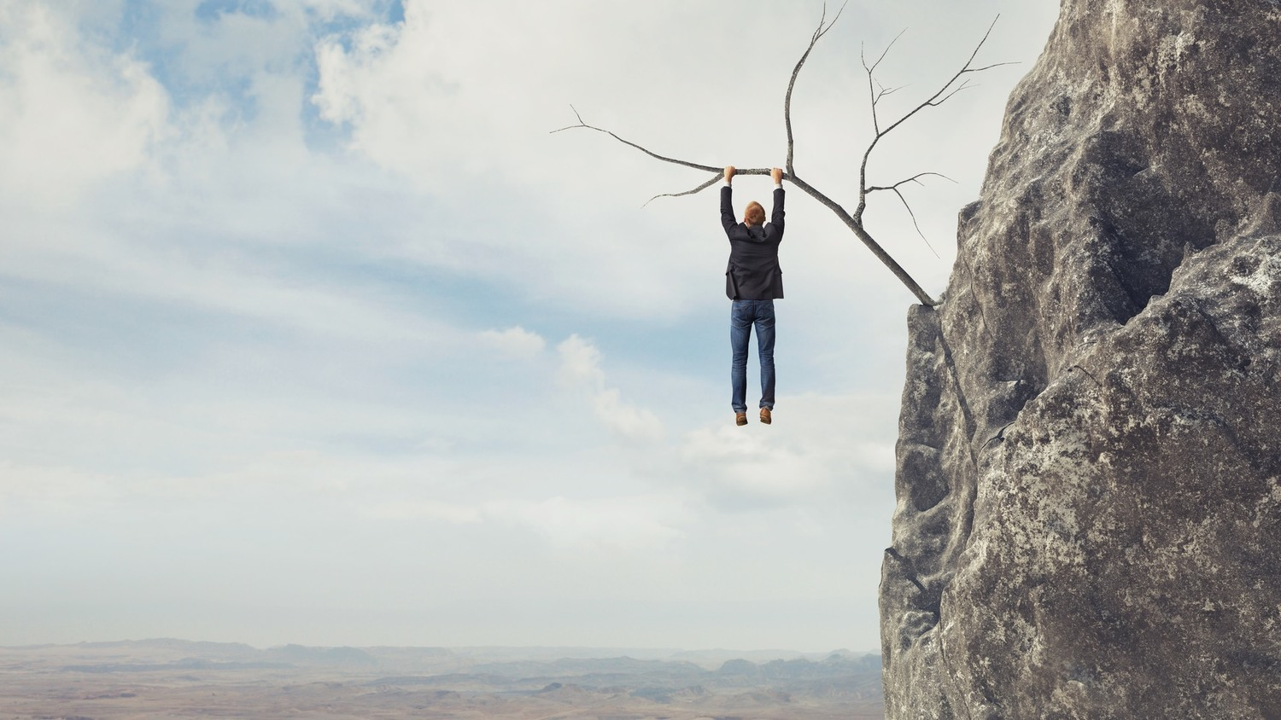
Background:
Judah hanging on a limb

Slide 33

Be Encouraged

Slide 34
The Postexilic Era
560
The Postexilic Era
Prophets:
Haggai
Zechariah
Malachi
605
586
539
536
520
516
483-473
444-425
Others:
Zerubbabel
Esther
Ezra
Nehemiah
Temple work

Slide 35
Dates in Zechariah
Begins Preaching
Night Visions Joshua Crowned
Oct/Nov
1:1-6
2/15
1:7-6:15
Prophecy #1
Rebuilding Resumes
Prophecy #2
Prophecies #3-4
Dates in Haggai
8/29
1:1
9/21
1:15
10/17
2:1
12/18
2:10, 18, 20
Aug
Sep
Oct
Nov
Dec
520 BC
519 BC

Slide 36
Book Chart
Rebuild Temple for Messiah
God's Covenant Faithfulness |  |  | Future Messianic Rule
Chapters 1–6 |  |  | Chapters 7–14
"The word of the LORD came to Zechariah…" (1:1) |  |  | "The word of the LORD came to Zechariah…" (7:1)
Visions of the Covenant |  |  | Visions of the Messiah
 |  |  |  | Two Burdens
Command to Repent 1:1-6 | Eight Covenantal Visions 1:7–6:8 | Joshua's Symbolic Coronation 6:9-15 | Four Restoration Messages 7–8 | Rejected at First Advent 9–11 | Received at Second Advent 12–14
"The word of the LORD came to Zechariah" | "Then I looked up—and there before me" | "The word of the LORD came to me" | "The word of the LORD came to me" | "The burden of the word of the LORD" (NASB) | "The burden of the word of the LORD" (NASB)
Pictures |  |  | Problems | Predictions
Israel's Fortune |  |  | Israel's Fasting | Israel's Future
While Building the Temple 520-518 BC (1:1; 7:1) |  |  |  | After Building the Temple 480-470 BC (9:13?)
Jerusalem
649
Rebuild Temple for Messiah

Slide 37
Slides on
Zechariah 1

Slide 38
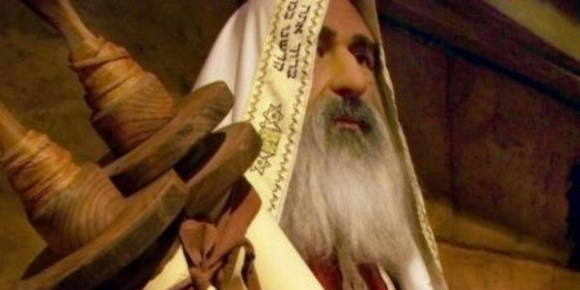
"In November of the second year of King Darius's reign, the LORD gave this message to the prophet Zechariah son of Berekiah and grandson of Iddo" (Zech 1:1 NLT).

Slide 39
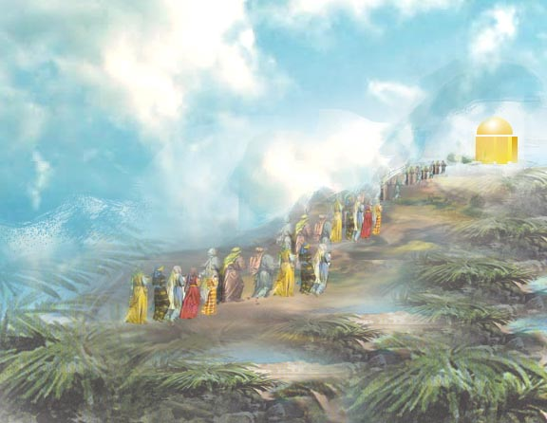

Meaning
650
hy"r>k;z>
"Yahweh has remembered" (Hebrew)
hy"r>k;z>

Slide 40
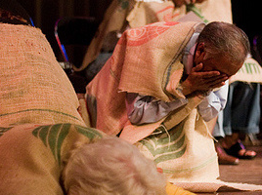
"I, the LORD, was very angry with your ancestors. ³Therefore, say to the people, 'This is what the LORD of Heaven's Armies says: Return to me, and I will return to you, says the LORD of Heaven's Armies'"
(Zech 1:2-3 NLT).

Slide 41
"Don't be like your ancestors who would not listen or pay attention when the earlier prophets said to them, 'This is what the LORD of Heaven's Armies says: Turn from your evil ways, and stop all your evil practices'"
(Zech 1:4 NLT).

Slide 42
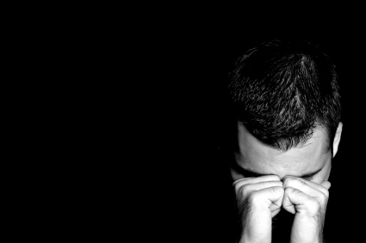
"Where are your ancestors now? They and the prophets are long dead. ⁶But everything I said through my servants the prophets happened to your ancestors, just as I said"
(Zech 1:5-6a NLT).

Slide 43
"As a result, they repented and said, 'We have received what we deserved from the LORD of Heaven's Armies. He has done what he said he would do'"
(Zech 1:6b NLT).

Slide 44
How can you be encouraged in your service for Christ?
2 ways

Slide 45
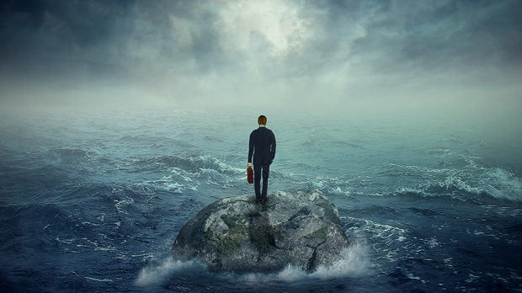
I. See your privileged position (Zech 1–6).

Slide 46
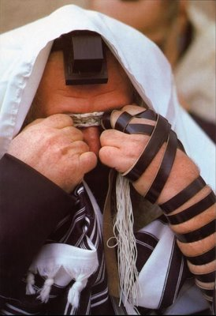
Even today Jews pray every day for the temple rebuilding
Israel's privileged position should result in temple rebuilding
(Chs. 1–6)

Slide 47
Book Chart
Rebuild Temple for Messiah
God's Covenant Faithfulness |  |  | Future Messianic Rule
Chapters 1–6 |  |  | Chapters 7–14
"The word of the LORD came to Zechariah…" (1:1) |  |  | "The word of the LORD came to Zechariah…" (7:1)
Visions of the Covenant |  |  | Visions of the Messiah
 |  |  |  | Two Burdens
Command to Repent 1:1-6 | Eight Covenantal Visions 1:7–6:8 | Joshua's Symbolic Coronation 6:9-15 | Four Restoration Messages 7–8 | Rejected at First Advent 9–11 | Received at Second Advent 12–14
"The word of the LORD came to Zechariah" | "Then I looked up—and there before me" | "The word of the LORD came to me" | "The word of the LORD came to me" | "The burden of the word of the LORD" (NASB) | "The burden of the word of the LORD" (NASB)
Pictures |  |  | Problems | Predictions
Israel's Fortune |  |  | Israel's Fasting | Israel's Future
While Building the Temple 520-518 BC (1:1; 7:1) |  |  |  | After Building the Temple 480-470 BC (9:13?)
Jerusalem
649
Rebuild Temple for Messiah

Slide 48
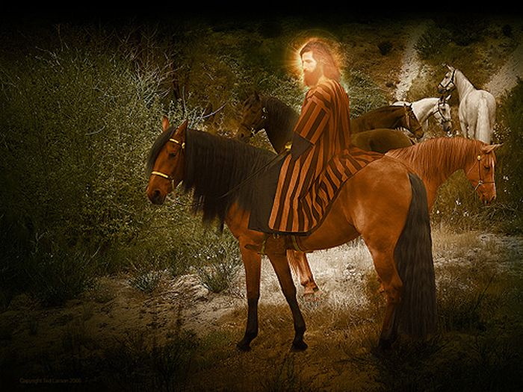
Vision 1: Red-Horse Rider among the Myrtles (Zech 1:7-17)
"Three months later, on February 15, the LORD sent another message to the prophet Zechariah son of Berekiah and grandson of Iddo. ⁸In a vision during the night, I saw a man sitting on a red horse that was standing among some myrtle trees in a small valley. Behind him were riders on red, brown, and white horses. ⁹I asked the angel who was talking with me, 'My lord, what do these horses mean?' 'I will show you,' the angel replied" (1:7-9 NLT).

Slide 49
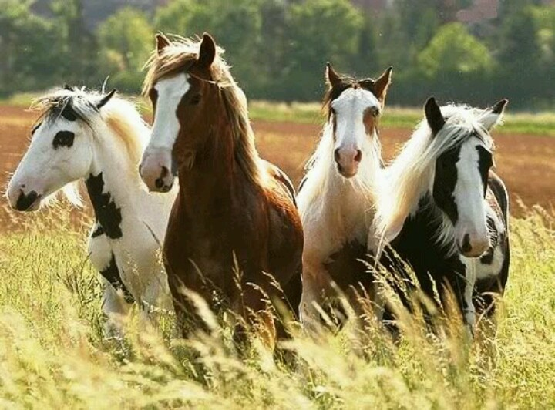
"The rider standing among the myrtle trees then explained, 'They are the ones the LORD has sent out to patrol the earth'" (1:10 NLT).

Slide 50
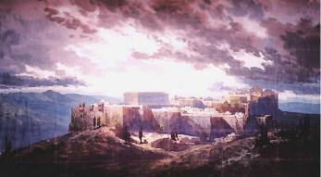
"Then the angel said to me, 'Shout this message for all to hear: "This is what the LORD of Heaven's Armies says: My love for Jerusalem and Mount Zion is passionate and strong. ¹⁵But I am very angry with the other nations that are now enjoying peace and security. I was only a little angry with my people, but the nations inflicted harm on them far beyond my intentions" ' " (1:14-15 NLT).

Slide 51
Vision 1: Red-Horse Rider among the Myrtles (Zech 1:7-17)
God's anger against the nations and blessing on restored Israel
Bible Knowledge Commentary, 1:1549

Slide 52
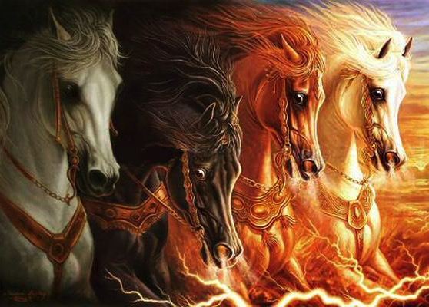
Zechariah 1:8 expands in Revelation 6:1-4

Slide 53
1:16 "My temple will be rebuilt!"
650

Slide 54
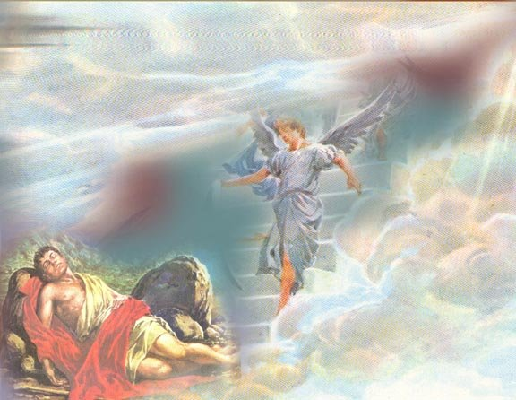
Eight Covenantal Visions
653
Vision | Text | Meaning
Red-Horse Rider among the Myrtles | 1:7-17 | God's anger against the nations and blessing on restored Israel
Four Horns and Four Craftsmen | 1:18-21 | God's judgment on the nations that afflict Israel
Surveyor with a Measuring Line | Zech. 2 | God's future blessing on restored Israel
Cleansing and Crowning of Joshua the High Priest | Zech. 3 | Israel's future cleansing from sin and reinstatement as a priestly nation
Golden Lampstand and Two Olive Trees | Zech. 4 | Israel as the light to the nations under Messiah, the King-Priest
Flying Scroll | 5:1-4 | Severity and totality of divine judgment on individual Israelites
Woman in the Ephah | 5:5-11 | Removal of national Israel's sin of rebellion against God
Four Chariots | 6:1-8 | Divine judgment on Gentile nations
Bible Knowledge Commentary, 1:1549

Slide 55
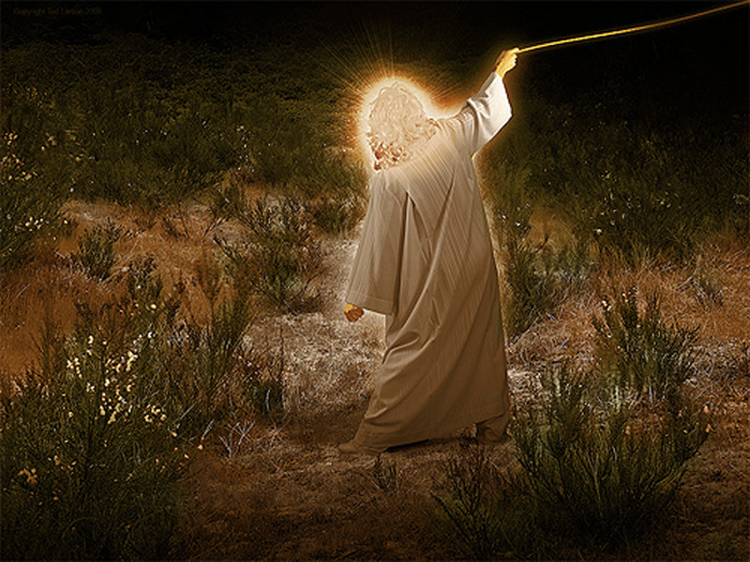
Vision 2: Four Horns and
Four Craftsmen (Zech 1:18-21)
God's judgment on the nations
that afflict Israel
Bible Knowledge Commentary, 1:1549

Slide 56
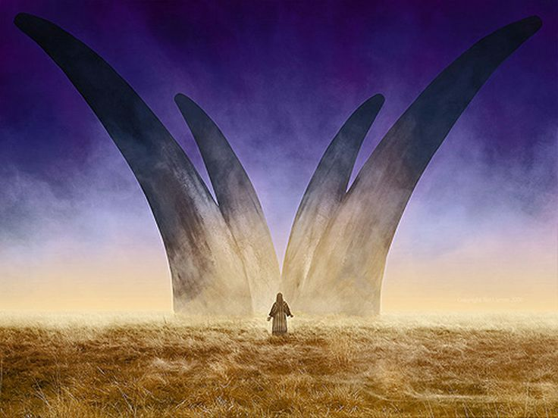
Zechariah's Second Vision:
The Horns and the Smiths (Craftsmen) in Zechariah 1:18-21
"Then I looked up and saw four animal horns. ^{19'}What are these?' I asked the angel who was talking with me. He replied, 'These horns represent the nations that scattered Judah, Israel, and Jerusalem'" (Zech 1:18-19 NLT).

Slide 57
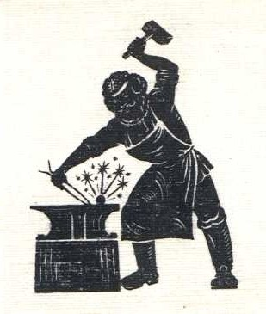
"Then the LORD showed me four blacksmiths. ²¹'What are these men coming to do?' I asked. The angel replied, 'These four horns—these nations—scattered and humbled Judah. Now these blacksmiths have come to terrify those nations and throw them down and destroy them'"
(Zech 1:20-21 NLT).

Slide 58
Slides on
Zechariah 2

Slide 59
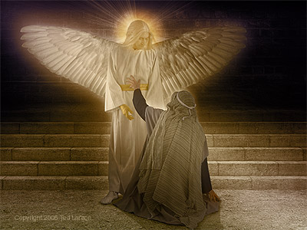
Vision 3: Surveyor with a Measuring Line (Zech 2)
God's future blessing on restored Israel
Bible Knowledge Commentary, 1:1549

Slide 60
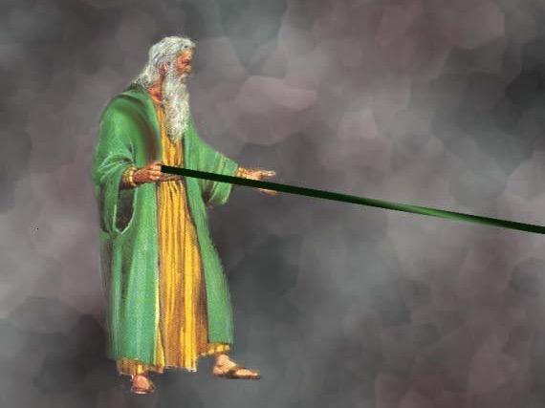
A Measuring Rod for Jerusalem (Zech. 2:1-2 NLT)
"When I looked again, I saw a man with a measuring line in his hand. ²'Where are you going?' I asked. He replied,
'I am going to measure Jerusalem, to see how wide and how long it is.'"

Slide 61

Jerusalem Population (2002)
East = Arabs
West = Jews

Slide 62
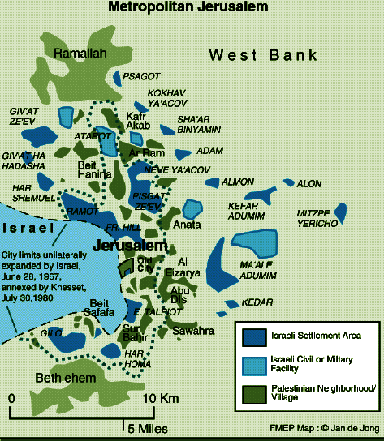
Jerusalem (2002)
Foundation for Middle East Peace
(March 2002)

Slide 63
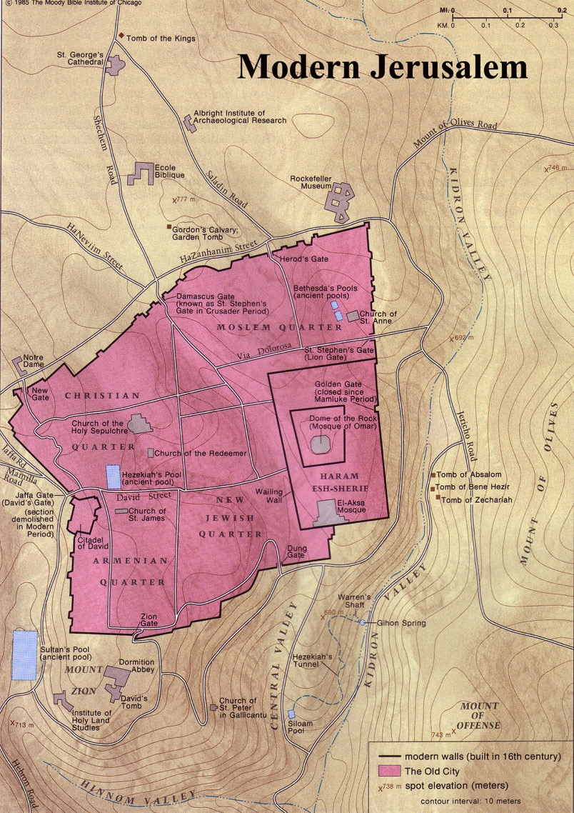
The Old City Today

Slide 64

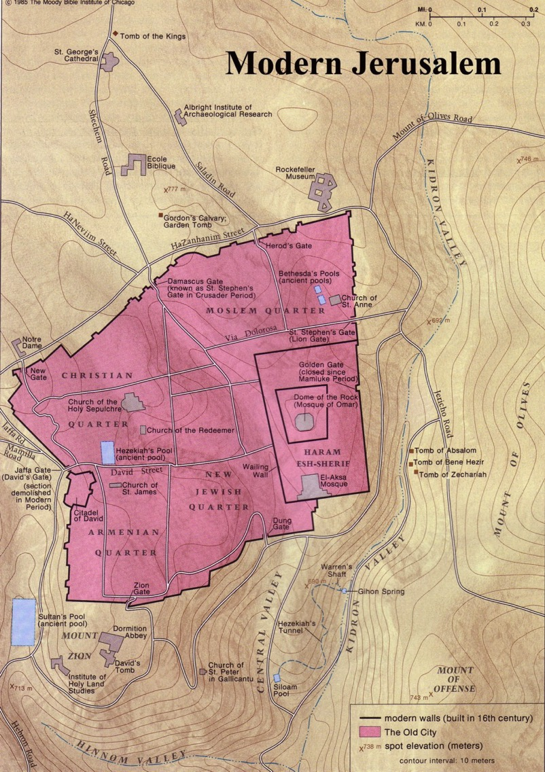

Modern Jerusalem: "Many will live outside the city walls" (Zech. 2:4)

Slide 65
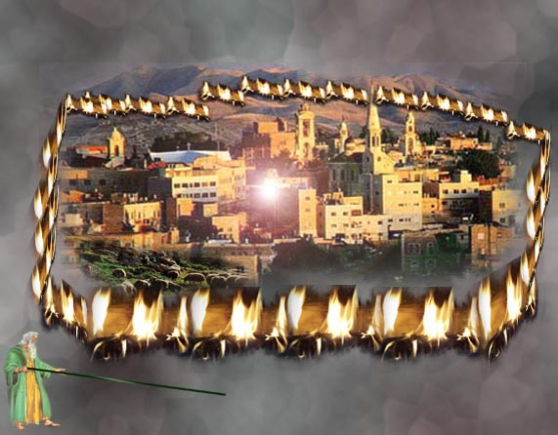
The Wall of Fire (Zech. 2:3-5 NLT)
649
"Then the angel who was with me went to meet a second angel who was coming toward him. ⁴The other angel said, 'Hurry, and say to that young man, 'Jerusalem will someday be so full of people and livestock that there won't be room enough for everyone! Many will live outside the city walls. ⁵Then I, myself, will be a protective wall of fire around Jerusalem, says the LORD. And I will be the glory inside the city!'"

Slide 66
Slides on
Zechariah 3

Slide 67
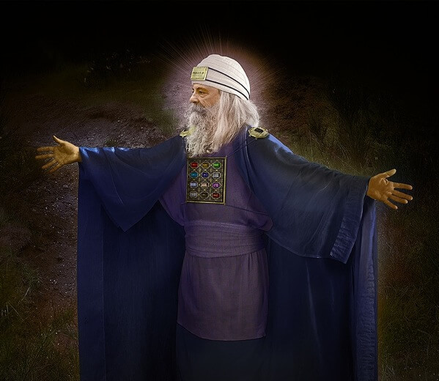
Vision 4: Cleansing and Crowning of Joshua the High Priest (Zech 3)
Israel's future cleansing from sin and reinstatement as a priestly nation
Bible Knowledge Commentary, 1:1549

Slide 68
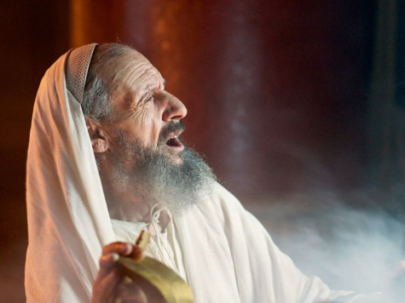
"Then the angel showed me Joshua the high priest standing before the angel of the LORD. The Accuser, Satan, was there at the angel's right hand, making accusations against Joshua. ²And the LORD said to Satan, 'I, the LORD, reject your accusations, Satan. Yes, the LORD, who has chosen Jerusalem, rebukes you. This man is like a burning stick that has been snatched from the fire'" (Zech 3:1-2 NLT).

Slide 69
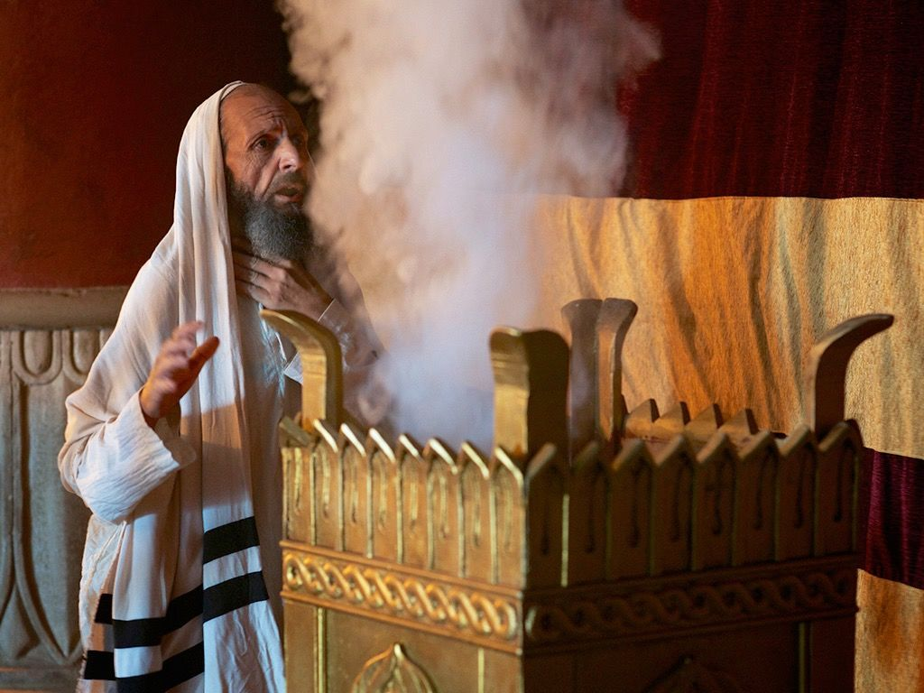
"Joshua's clothing was filthy as he stood there before the angel. ⁴So the angel said to the others standing there, 'Take off his filthy clothes.' And turning to Joshua he said, 'See, I have taken away your sins, and now I am giving you these fine new clothes'" (Zech 3:3-4 NLT).

Slide 70
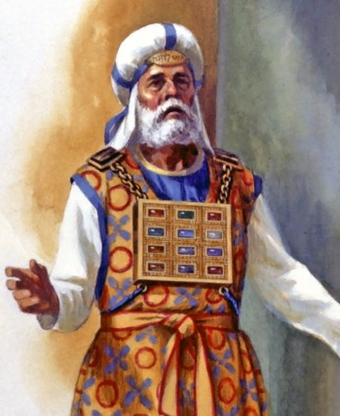
"Then I said, 'They should also place a clean turban on his head.' So they put a clean priestly turban on his head and dressed him in new clothes while the angel of the LORD stood by'"
(Zech 3:5 NLT).

Slide 71
Vision 4: Cleansing and Crowning of Joshua the High Priest (Zech 3)
Israel's future cleansing from sin and reinstatement as a priestly nation
Bible Knowledge Commentary, 1:1549

Slide 72
Slides on
Zechariah 4

Slide 73
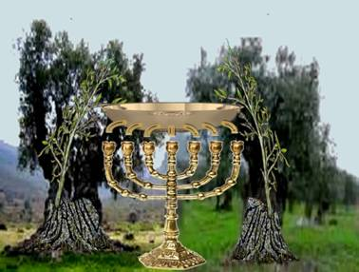
The Lamp & Olive Trees (Zech. 4:1-14)
"Then the angel who had been talking with me returned and woke me, as though I had been asleep. ²'What do you see now?' he asked" (Zech 4:1-2a NLT).

Slide 74
"'I see a solid gold lampstand with a bowl of oil on top of it. Around the bowl are seven lamps, each having seven spouts with wicks" (Zech 4:2a NLT).

Slide 75
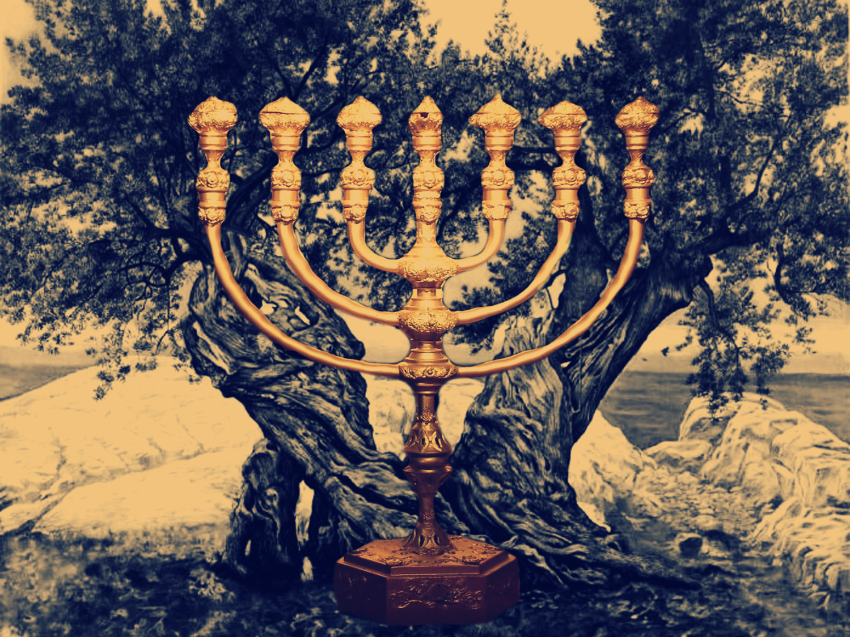
Vision 5: Golden Lampstand and Two Olive Trees (Zech 4)
Israel as the light to the nations under Messiah, the King-Priest
Bible Knowledge Commentary, 1:1549

Slide 76
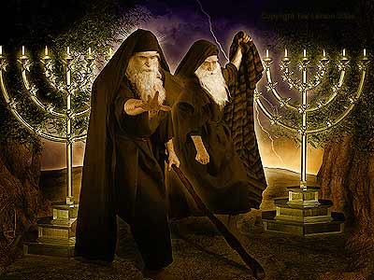
The Two Olive Trees (Rev. 11:4)
330

Slide 77
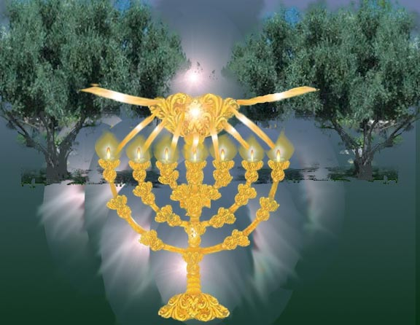
The Lamp & Olive Trees (Zech. 4:1-14)
"'Zerubbabel is the one who laid the foundation of this Temple, and he will complete it. Then you will know that the LORD of Heaven's Armies has sent me. ¹⁰Do not despise these small beginnings, for the LORD rejoices to see the work begin, to see the plumb line in Zerubbabel's hand.' (The seven lamps represent the eyes of the LORD that search all around the world.)" (Zech. 4:9-10 NLT)

Slide 78
Slides on
Zechariah 5

Slide 79
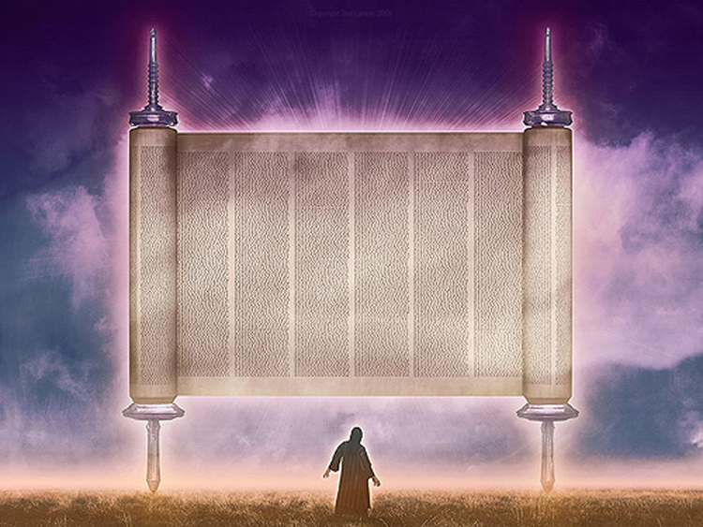
Vision 6: The Flying Scroll (Zech 5:1-4)
Severity and totality of divine judgment on individual Israelites
Bible Knowledge Commentary, 1:1549

Slide 80
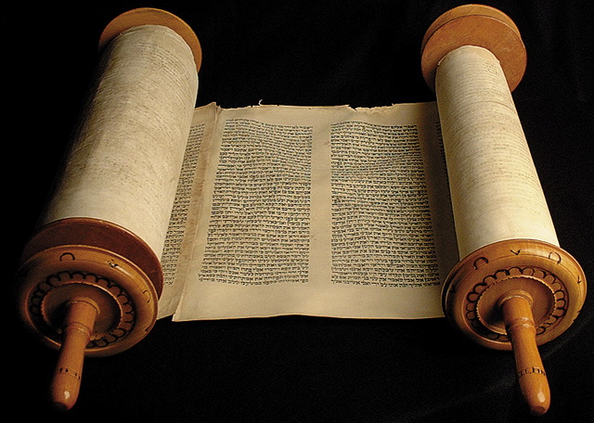
5:1-4 Flying Scroll

Slide 81
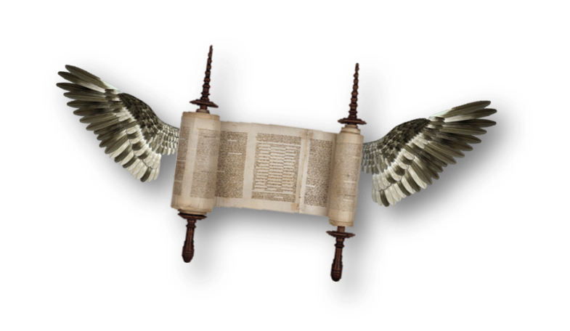
"I looked up again and saw a scroll flying through the air. ²'What do you see?' the angel asked. 'I see a flying scroll,' I replied. 'It appears to be about 30 feet long and 15 feet wide'" (Zech 5:1-2 NLT).

Slide 82
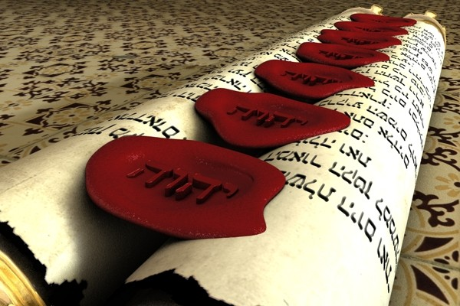
"Then he said to me, 'This scroll contains the curse that is going out over the entire land. One side of the scroll says that those who steal will be banished from the land; the other side says that those who swear falsely will be banished from the land'"
(Zech 5:3 NLT).

Slide 83
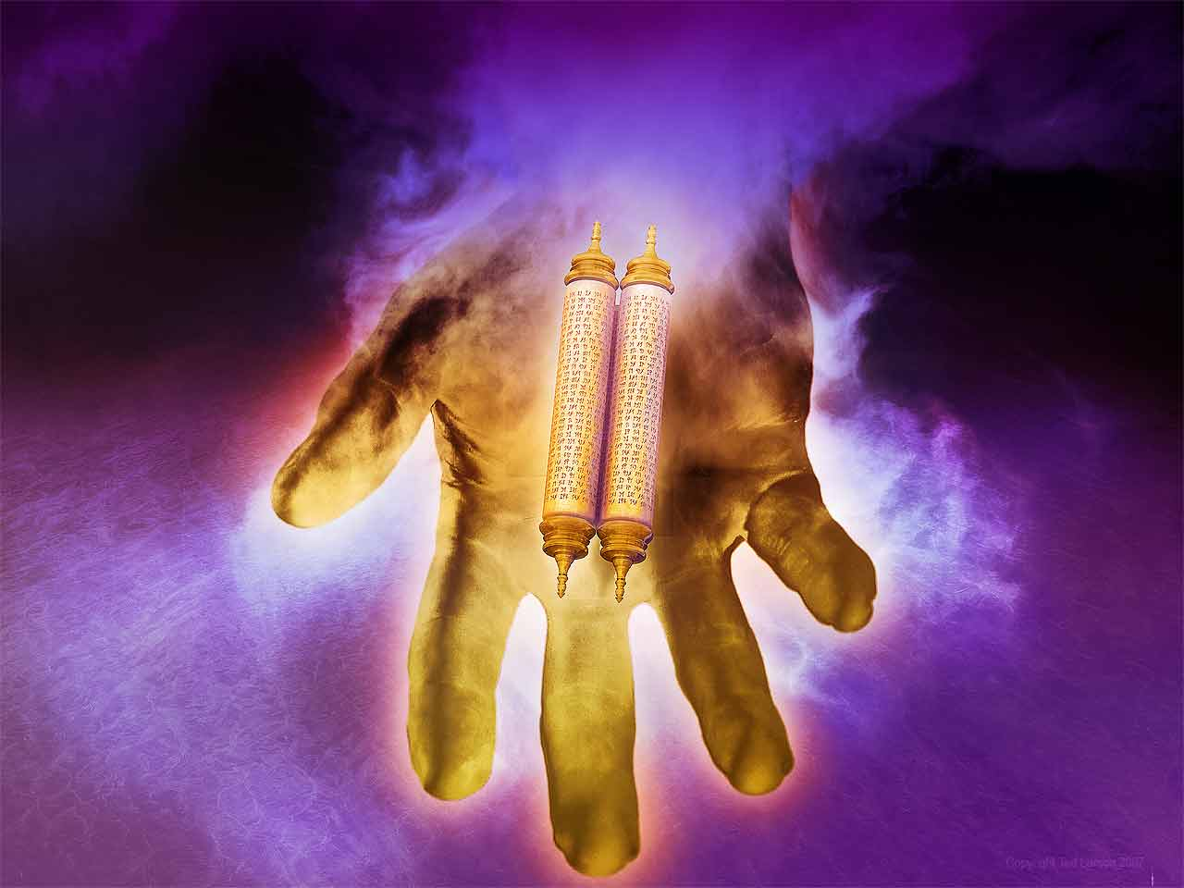
"And this is what the LORD of Heaven's Armies says: I am sending this curse into the house of every thief and into the house of everyone who swears falsely using my name. And my curse will remain in that house and completely destroy it—even its timbers and stones" (Zech 5:4 NLT).

Slide 84
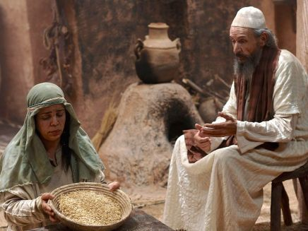
Baskets were very familiar to Zechariah

Slide 85

Vision 7: Woman in the Ephah
(Zech 5:5-11)
Removal of national Israel's sin of rebellion against God
Bible Knowledge Commentary, 1:1549

Slide 86

5:5-8 Woman in Basket
"Then the angel who was talking with me came forward and said, 'Look up and see what's coming.' ⁶'What is it?' I asked. He replied, 'It is a basket for measuring grain, and it's filled with the sins of everyone throughout the land.' ⁷Then the heavy lead cover was lifted off the basket, and there was a woman sitting inside it"
(Zech 5:5-7 NLT).

Slide 87

"The angel said, 'The woman's name is Wickedness,' and he pushed her back into the basket and closed the heavy lid again"
(Zech 5:8 NLT).

Slide 88

"The angel said, 'The woman's name is Wickedness,' and he pushed her back into the basket and closed the heavy lid again"
(Zech 5:8 NLT).

Slide 89

5:9-11 Woman in Basket
^{9 "}Then I looked up and saw two women flying toward us, gliding on the wind. They had wings like a stork, and they picked up the basket and flew into the sky. ¹⁰ 'Where are they taking the basket?' I asked the angel. ¹¹ He replied, 'To the land of Babylonia, where they will build a temple for the basket. And when the temple is ready, they will set the basket there on its pedestal'" (Zech 5:9-11 NLT).

Slide 90

5:5-8 Woman in Basket
"Then I looked up and saw two women flying toward us, gliding on the wind. They had wings like a stork, and they picked up the basket and flew into the sky"
(Zech 5:9 NLT).

Slide 91

Wickedness sometimes appears in the imagery of women.
Zechariah 5:9 is one of two places that mention female supernatural beings.

Slide 92
Slides on
Zechariah 6

Slide 93

Vision 8: The Four Chariots (Zech 6:1-8)
"Then I looked up again and saw four chariots coming from between two bronze mountains. ²The first chariot was pulled by red horses, the second by black horses, ³the third by white horses, and the fourth by powerful dappled-gray horses."
"⁴'And what are these, my lord?' I asked the angel who was talking with me" (Zech 6:1-4 NLT).
Bible Knowledge Commentary, 1:1549

Slide 94

6:1-8 Chariots
"The angel replied, 'These are the four spirits of heaven who stand before the LORD of all the earth. They are going out to do his work.
649
South
West
⁶The chariot with black horses is going north, the chariot with white horses is going west, and the chariot with dappled-gray horses is going south'"
(Zech 6:5-6 NLT).
North

Slide 95

Vision 8: The Four Chariots (Zech 6:1-8)
Divine judgment on Gentile nations
Bible Knowledge Commentary, 1:1549

Slide 96

The Night Visions Reviewed
  red-horse rider among the myrtles 1:7-17
  four horns & the four craftsmen 1:18-21
  surveyor with the measuring line 2:1-13
  cleansing & crowning of Joshua 3:1-10
  gold lampstand & the two olive trees 4:1-14
  flying scroll 5:1-4
  woman in the ephah 5:5-11
  four chariots 6:1-8

Slide 97

God also encourages us to serve him by revealing our identity in Christ.

Slide 98

Our Identity in Christ

Slide 99
How can you be encouraged in your service for Christ?
2 ways

Slide 100
I. See your privileged position (Zech 1–6).

Slide 101

II. See your glorious future (Zech 7–14).

Slide 102
Slides on
Zechariah 7

Slide 103


The Postexilic Era
295-296
The Postexilic Era
Temple work
Haggai
"On December 7 of the fourth year of King Darius's reign, another message came to Zechariah from the LORD"
(Zech 7:1 NLT).
Prophets:
Zechariah
605
586
539
536
520
516
Others:
Zerubbabel
Persian Kings:
Cyrus
Darius
Notes:
This was King Darius's second year, in 520 BC (1:1)

Slide 104

"The people of Bethel had sent Sharezer and Regemmelech, along with their attendants, to seek the LORD's favor. ³They were to ask this question of the prophets and the priests at the Temple of the LORD of Heaven's Armies: 'Should we continue to mourn and fast each summer on the anniversary of the Temple's destruction, as we have done for so many years?'"
(Zech 7:2-3 NLT).

Slide 105
"The LORD of Heaven's Armies sent me this message in reply: ⁵'Say to all your people and your priests, "During these seventy years of exile, when you fasted and mourned in the summer and in early autumn, was it really for me that you were fasting? ⁶And even now in your holy festivals, aren't you eating and drinking just to please yourselves?"'"
(7:4-6 NLT).

Slide 106
Book Chart
Rebuild Temple for Messiah
God's Covenant Faithfulness |  |  | Future Messianic Rule
Chapters 1–6 |  |  | Chapters 7–14
"The word of the LORD came to Zechariah…" (1:1) |  |  | "The word of the LORD came to Zechariah…" (7:1)
Visions of the Covenant |  |  | Visions of the Messiah
 |  |  |  | Two Burdens
Command to Repent 1:1-6 | Eight Covenantal Visions 1:7–6:8 | Joshua's Symbolic Coronation 6:9-15 | Four Restoration Messages 7–8 | Rejected at First Advent 9–11 | Received at Second Advent 12–14
"The word of the LORD came to Zechariah" | "Then I looked up—and there before me" | "The word of the LORD came to me" | "The word of the LORD came to me" | "The burden of the word of the LORD" (NASB) | "The burden of the word of the LORD" (NASB)
Pictures |  |  | Problems | Predictions
Israel's Fortune |  |  | Israel's Fasting | Israel's Future
While Building the Temple 520-518 BC (1:1; 7:1) |  |  |  | After Building the Temple 480-470 BC (9:13?)
Jerusalem
649

Slide 107
7:1–8:23 Fasts in Zechariah
657
Text | Month/Day | Fast Commemorates: | Scripture
8:19d | 10/10 | Nebuchadnezzar Began Jerusalem Siege (15 January 588) | Jer. 39:1; 52:4; 2 Kings 25:1
8:19a | 4/9 | Jerusalem Destroyed (18 July 586) | Jer. 39:2; 52:6; 2 Kings 25:3
7:3, 5 8:19b | 5/10 | Jerusalem & Temple Burned (15-18 August 586) | Jer. 52:12-13; 2 Kings 25:8
7:5 8:19c | 7/3 | Gedaliah Slain (9 October 586) | Jer. 41:1-3 2 Kings 25:25-26
Adapted from a Dallas Theological Seminary Class Handout

Slide 108
Slides on
Zechariah 8

Slide 109

"Then another message came to me from the LORD of Heaven's Armies: 'This is what the LORD of Heaven's Armies says: My love for Mount Zion is passionate and strong; I am consumed with passion for Jerusalem!"
(Zech 8:1-2 NLT).

Slide 110
Key Verse
649
"This is what the LORD says, 'I will return to Zion and dwell in Jerusalem. Then Jerusalem will be called The City of Truth, and the mountain of the LORD Almighty will be called The Holy Mountain'" (Zechariah 8:3).
Zechariah

Slide 111

Jews will be sought out
649
"This is what the LORD of Heaven's Armies says: In those days ten men from different nations and languages of the world will clutch at the sleeve of one Jew. And they will say, 'Please let us walk with you, for we have heard that God is with you'" (Zech. 8:23 NLT).

Slide 112

"All Israel will be saved" (Rom. 11:25-27)
NTS 155w
²⁵I do not want you to be ignorant of this mystery, brothers, so that you may not be conceited: Israel has experienced a hardening in part until the full number of the Gentiles has come in.
²⁶And so all Israel will be saved, as it is written:
"The deliverer will come from Zion; he will turn godlessness away from Jacob.
²⁷And this is my covenant with them when I take away their sins."

Slide 113

Zech-a-Cry-Ah
= Key Word

Slide 114
Slides on
Zechariah 9

Slide 115
Key Word
649
343
Messiah
Zechariah

Slide 116
Zechariah Kingdom Statement
343
Judah must rebuild the temple (6:9-15) for blessing in the Messiah's kingdom.

Slide 117
Barry Huddleston, The Acrostic Summarized Bible (Grand Rapids: Baker, 1992)
Zechariah
1 Meaning of Zechariah's vision
2 Examination with measuring line
3 Satan and the Branch
4 Seven lampstands of gold
5 Interpreting the flying scroll
6 Act of crowning Joshua
7 Hearts become like flint
8 Security comes to Jerusalem
9 Return of the Messiah
10 Ephraim and Judah restored
11 Teaching about wicked shepherds
12 Understanding whom they pierced
13 Refining of God's remnant
14 New kingdom ushered in

Slide 118

Judgments
Hamath
"This is the message from the LORD against the land of Aram and the city of Damascus, for the eyes of humanity, including all the tribes of Israel, are on the LORD. ²Doom is certain for Hamath, near Damascus, and for the cities of Tyre and Sidon, though they are so clever. ³Tyre has built a strong fortress and has made silver and gold as plentiful as dust in the streets! ⁴But now the LORD will strip away Tyre's possessions and hurl its fortifications into the sea, and it will be burned to the ground."
Damascus
Sidon
Tyre
Aram
Israel
Zechariah 9:1-4 NLT

Slide 119
Book Chart
Rebuild Temple for Messiah
God's Covenant Faithfulness |  |  | Future Messianic Rule
Chapters 1–6 |  |  | Chapters 7–14
"The word of the LORD came to Zechariah…" (1:1) |  |  | "The word of the LORD came to Zechariah…" (7:1)
Visions of the Covenant |  |  | Visions of the Messiah
 |  |  |  | Two Burdens
Command to Repent 1:1-6 | Eight Covenantal Visions 1:7–6:8 | Joshua's Symbolic Coronation 6:9-15 | Four Restoration Messages 7–8 | Rejected at First Advent 9–11 | Received at Second Advent 12–14
"The word of the LORD came to Zechariah" | "Then I looked up—and there before me" | "The word of the LORD came to me" | "The word of the LORD came to me" | "The burden of the word of the LORD" (NASB) | "The burden of the word of the LORD" (NASB)
Pictures |  |  | Problems | Predictions
Israel's Fortune |  |  | Israel's Fasting | Israel's Future
While Building the Temple 520-518 BC (1:1; 7:1) |  |  |  | After Building the Temple 480-470 BC (9:13?)
Jerusalem
649

Slide 120

Triumphal Entry
Zech. 9:9

Slide 121
Slides on
Zechariah 10

Slide 122

"Ask the LORD for rain in the spring, for he makes the storm clouds. And he will send showers of rain so every field becomes a lush pasture. ²Household gods give worthless advice, fortune-tellers predict only lies, and interpreters of dreams pronounce falsehoods that give no comfort. So my people are wandering like lost sheep; they are attacked because they have no shepherd" (Zech 10:1-2 NLT).

Slide 123
Slides on
Zechariah 11

Slide 124
Judgments
"Open your doors, Lebanon,
so that fire may devour your cedar forests.
²Weep, you cypress trees, for all the ruined cedars;
the most majestic ones have fallen.
Weep, you oaks of Bashan,
for the thick forests have been cut down.
³Listen to the wailing of the shepherds,
for their rich pastures are destroyed.
Hear the young lions roaring,
for their thickets in the Jordan Valley are ruined."
Sidon
Lebanon
Tyre
Bashan
Israel
Zechariah 11:1-3 NLT

Slide 125
Slides on
Zechariah 12

Slide 126
"This message concerning the fate of Israel came from the LORD: 'This message is from the LORD, who stretched out the heavens, laid the foundations of the earth, and formed the human spirit. ²I will make Jerusalem like an intoxicating drink that makes the nearby nations stagger when they send their armies to besiege Jerusalem and Judah'"
(Zech 12:1-2 NLT).

Slide 127
Book Chart
Rebuild Temple for Messiah
God's Covenant Faithfulness |  |  | Future Messianic Rule
Chapters 1–6 |  |  | Chapters 7–14
"The word of the LORD came to Zechariah…" (1:1) |  |  | "The word of the LORD came to Zechariah…" (7:1)
Visions of the Covenant |  |  | Visions of the Messiah
 |  |  |  | Two Burdens
Command to Repent 1:1-6 | Eight Covenantal Visions 1:7–6:8 | Joshua's Symbolic Coronation 6:9-15 | Four Restoration Messages 7–8 | Rejected at First Advent 9–11 | Received at Second Advent 12–14
"The word of the LORD came to Zechariah" | "Then I looked up—and there before me" | "The word of the LORD came to me" | "The word of the LORD came to me" | "The burden of the word of the LORD" (NASB) | "The burden of the word of the LORD" (NASB)
Pictures |  |  | Problems | Predictions
Israel's Fortune |  |  | Israel's Fasting | Israel's Future
While Building the Temple 520-518 BC (1:1; 7:1) |  |  |  | After Building the Temple 480-470 BC (9:13?)
Jerusalem
649

Slide 128

The Repentance of Israel
"Then I will pour out a spirit of grace and prayer on the family of David and on the people of Jerusalem. They will look on me whom they have pierced and mourn for him as for an only son. They will grieve bitterly for him as for a firstborn son who has died"
(Zech. 12:10 NLT).

Slide 129

Tribulation Results
"They will look on the one they have pierced…"
(Zech. 12:1-10; esp. v. 10)
"The Redeemer will come to Zion, to those in Jacob who repent of their sins" (Isa. 59:20)
"The deliverer will come from Zion; he will turn godlessness away from David"
(Rom. 11:26b)
"And so all Israel will be saved" (Rom. 11:26a)

Slide 130

"Look!
He comes with the clouds of heaven.
And everyone will see him— even those who pierced him.
And all the nations of the world will mourn for him. Yes! Amen!"
Rev. 1:7 NLT
cf. Zech. 12:10

Slide 131
Amillennialism
473
Second Coming
Spiritual reign of Christ
Tribulations
Church Age
Eternal Kingdom
Judgment
Notes:
131

Slide 132
Premillennialism
473
Second Coming
Second Advent
=
Tribulation
Millennium
Church Age
Eternal Kingdom
7 years
1000 years
Judgment
Judgment
Notes:
132

Slide 133
A Dispensational Timeline
437
Great
White
Throne
(Rev. 20:11-14)
Rapture
(1 Thess. 4:13-18)
2nd Advent
(Zech. 14:3-5)
Day of the LORD
Church Age
Tribulation
(Zech. 14:1-2)
Millennium
(Zech. 14:6-21)
Gog & Magog
(Armageddon)
(Ezek. 38–39)
Gog and Magog
Revisited
(Rev. 20:7-10)
Notes:
133

Slide 134
Slides on
Zechariah 13

Slide 135

"On that day a fountain will be opened for the dynasty of David and for the people of Jerusalem, a fountain to cleanse them from all their sins and impurity" (Zech 13:1 NLT).

Slide 136

"'And on that day,' says the LORD of Heaven's Armies, 'I will erase idol worship throughout the land, so that even the names of the idols will be forgotten. I will remove from the land both the false prophets and the spirit of impurity that came with them'" (Zech 13:2 NLT).

Slide 137

"'Awake, O sword, against my shepherd, the man who is my partner,' says the LORD of Heaven's Armies. 'Strike down the shepherd, and the sheep will be scattered, and I will turn against the lambs. ⁸Two-thirds of the people in the land will be cut off and die,' says the LORD. 'But one-third will be left in the land'"
(Zech 13:7-8 NLT).

Slide 138

"I will bring that group through the fire and make them pure.
I will refine them like silver and purify them like gold.
They will call on my name, and I will answer them.
I will say, 'These are my people,' and they will say, 'The LORD is our God'"
(Zech 13:9 NLT).

Slide 139
Slides on
Zechariah 14

Slide 140
Jerusalem Population (2002)
East = Arabs
West = Jews

Slide 141

The Plundering
"Watch, for the day of the LORD is coming when your possessions will be plundered right in front of you!"
(Zech. 14:1).

Slide 142


The Attack
"I will gather all the nations to fight against Jerusalem. The city will be taken, the houses looted, and the women raped. Half the population will be taken into captivity, and the rest will be left among the ruins of the city" (Zech. 14:2 NLT).

Slide 143
A Dispensational Timeline
437
Great
White
Throne
(Rev. 20:11-14)
Rapture
(1 Thess. 4:13-18)
2nd Advent
(Zech. 14:3-5)
Day of the LORD
Church Age
Tribulation
(Zech. 14:1-2)
Millennium
(Zech. 14:6-21)
Gog & Magog
(Armageddon)
(Ezek. 38–39)
Gog and Magog
Revisited
(Rev. 20:7-10)
Notes:
143

Slide 144

Christ's Return
"Then the LORD will go out to fight against those nations, as he has fought in times past"
(Zech. 14:3 NLT).

Slide 145

The Second Coming
"On that day, his feet will stand on the Mount of Olives east of Jerusalem"
(Zech. 14:4).

Slide 146






The Spirit Leaves & Returns
656
Ezek. 8:4; 9:3; 10:4; 10:18-19; 11:23
Luke 19:37; 24:50; Acts 1:10
Acts 1:11; Zech. 14:4; Ezek. 43:1-5

Slide 147

The Second Coming
"On that day, his feet will stand on the Mount of Olives east of Jerusalem…"
(Zech. 14:4a).

Slide 148

The Second Coming
"…And the Mount of Olives will split apart, making a wide valley running from east to west. Half the mountain will move toward the north and half toward the south"
(Zech. 14:4b NLT).

Slide 149
The Second Coming
"You will flee through this valley, for it will reach across to Azal. Yes, you will flee as you did from the earthquake in the days of King Uzziah of Judah. Then the LORD my God will come, and all his holy ones with him"
(Zech. 14:5 NLT).

Slide 150

The Second Coming
"On that day the sources of light will no longer shine, ⁷yet there will be continuous day! Only the LORD knows how this could happen. There will be no normal day and night, for at evening time it will still be light" (Zech. 14:6-7 NLT).

Slide 151

Living Water!
"On that day life-giving waters will flow out from Jerusalem, half toward the Dead Sea and half toward the Mediterranean, flowing continuously in both summer and winter" (Zech. 14:8 NLT).

Slide 152

The Second Coming
"And the LORD will be king over all the earth.
On that day there will be one LORD—
his name alone will be worshiped"
(Zech. 14:9 NLT).

Slide 153

Jerusalem Repopulated
655
¹⁰ All the land from Geba, north of Judah, to Rimmon, south of Jerusalem, will become one vast plain. But Jerusalem will be raised up in its original place and will be inhabited all the way from the Benjamin Gate over to the site of the old gate, then to the Corner Gate, and from the Tower of Hananel to the king's winepresses. ¹¹ And Jerusalem will be filled, safe at last, never again to be cursed and destroyed"
(Zech. 14:10-11 NLT).
Tower of Hananel
Tower of 100
Mount of Olives
Sheep Gate
Fish Gate
Inspection Gate
Jeshanah (Old Gate?)
East Gate
Broad Wall
Horse Gate
Tower of the Ovens?
Wall of Ophel
Great Projecting Tower
Valley Gate
Water Gate
Dung Gate
The Angle
Pool of Shelah (Siloam)
Fountain Gate

Slide 154

The Second Coming
"And the LORD will send a plague on all the nations that fought against Jerusalem. Their people will become like walking corpses, their flesh rotting away. Their eyes will rot in their sockets, and their tongues will rot in their mouths"
(Zech. 14:12 NLT).

Slide 155

The Second Coming
"On that day they will be terrified, stricken by the LORD with great panic. They will fight their neighbors hand to hand. ¹⁴Judah, too, will be fighting at Jerusalem. The wealth of all the neighboring nations will be captured—great quantities of gold and silver and fine clothing"
(Zech. 14:13-14 NLT).

Slide 156

The Second Coming
"This same plague will strike the horses, mules, camels, donkeys, and all the other animals in the enemy camps"
(Zech. 14:15 NLT).

Slide 157
A Dispensational Timeline
437
Great
White
Throne
(Rev. 20:11-14)
Rapture
(1 Thess. 4:13-18)
2nd Advent
(Zech. 14:3-5)
Day of the LORD
Church Age
Tribulation
(Zech. 14:1-2)
Millennium
(Zech. 14:6-21)
Gog & Magog
(Armageddon)
(Ezek. 38–39)
Gog and Magog
Revisited
(Rev. 20:7-10)
Notes:
157

Slide 158

Millennial Worship
"In the end, the enemies of Jerusalem who survive the plague will go up to Jerusalem each year to worship the King... and to celebrate the Festival of Shelters. ¹⁷Any nation in the world that refuses to come to Jerusalem to worship the King... will have no rain. ¹⁸If the people of Egypt refuse to attend the festival, the LORD will punish them with the same plague that he sends on the other nations who refuse to go. ¹⁹Egypt and the other nations will all be punished if they don't go to celebrate the Festival of Shelters"
(Zech. 14:16-19 NLT).

Slide 159


Millennial Holiness
^{20 "}On that day even the harness bells of the horses will be inscribed with these words: Holy to the LORD. And the cooking pots in the Temple of the LORD will be as sacred as the basins used beside the altar.
²¹ In fact, every cooking pot in Jerusalem and Judah will be holy to the LORD... All who come to worship will be free to use any of these pots to boil their sacrifices. And on that day there will no longer be traders [Heb. Canaanites] in the Temple of the LORD of Heaven's Armies."
(Zech. 14:20-21 NLT)

Slide 160
Zechariah
Summary Statement
649
346
Zechariah prepares Judah for the Messiah by encouraging the nation to respond to its privileged covenant position among the nations by rebuilding the temple in light of future blessings when the Messiah rules in the kingdom.

Slide 161

Millennial Jerusalem
106
"The law will go out from Zion,
the word of the LORD from Jerusalem"
––Isaiah 2:3

Slide 162

We also will rule with Israel after Christ's return.
Notes:
Christians who abandon Jesus will not reign with him after he returns.

Slide 163

Do you need encouragement today?

Slide 164
Main Idea
The way to fight discouragement is to...
see who you are
and where you are going.

Slide 165
I. See your privileged position (Zech 1–6).

Slide 166
II. See your glorious future (Zech 7–14).

Slide 167
Questions to Ponder
How can you better understand your exalted position in Christ?
————————
How can you better serve Christ now in light of your rule with him at his return?

Slide 168
Black

Slide 169


OT Preaching link at BibleStudyDownloads.org
Get this presentation and script for free!

